Slide 1
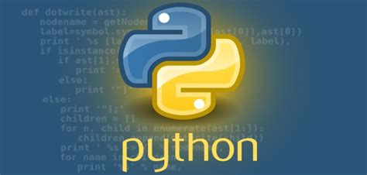
Introduction to Python Functions

Slide 2

Content
1. Understanding Functions
2. Creating and Using Functions
3. Advanced Function Concepts
4. Practical Applications of Functions

Slide 3

Understanding Functions
Section 1

Slide 4




What are Python Functions?
Definition
A Python function is a block of organized, reusable code that performs a specific task when called.
Modularity
Functions provide better modularity by allowing you to break down your program into smaller, manageable pieces.
Reusability
They enable you to reuse the code and avoid redundancy in your programs.
01
02
03

Slide 5
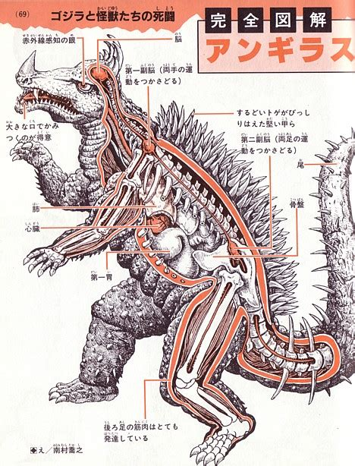
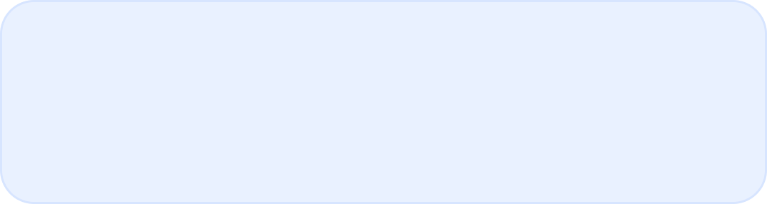
Anatomy of a Python Function
Function Structure
Functions consist of a function name, parameters, a colon, and an indented block of code.
Parameters
Data can be passed into a function as parameters to customize its behavior.
Return Statement
Functions can return data as output after performing their tasks.

Slide 6
Benefits of Using Functions
Code Organization
Functions help in organizing code and making it more readable and maintainable.
Abstraction
They allow you to abstract away complex operations into simple function calls.
Code Reusability
Functions promote code reusability, reducing the need for redundant code.
01
02
03

Slide 7
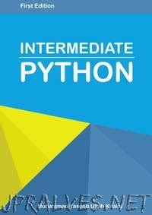



Commonly Used Python Functions
Built-in Functions
Python provides a wide range of built-in functions for common tasks like mathematical operations, string manipulation, and more.
User-Defined Functions
In addition to built-in functions, Python allows you to define your own custom functions to suit your specific needs.
Library Functions
Python libraries offer numerous specialized functions for various purposes, such as data manipulation, visualization, and more.

Slide 8
Creating and Using Functions
Section 2

Slide 9
Defining a Function
Function Declaration
To define a function, you use the `def` keyword followed by the function name and parentheses.
Function Parameters
Parameters are specified within the parentheses to allow the function to accept input data.
Function Body
The function body contains the code that defines the task to be performed.
01
02
03

Slide 10
Calling a Function
Function Invocation
To execute a function, you simply use the function name followed by parentheses.
Argument Passing
Arguments are passed within the parentheses to provide input data to the function.
Return Value
If the function returns a value, it can be stored in a variable or used directly in the program.

Slide 11
Scope and Lifetime of Variables
Local Variables
Variables defined inside a function have local scope and are only accessible within that function.
Global Variables
Variables defined outside of any function have global scope and can be accessed from anywhere in the program.
Lifetime of Variables
The lifetime of a variable is the period during which it exists in the memory.
01
02
03

Slide 12
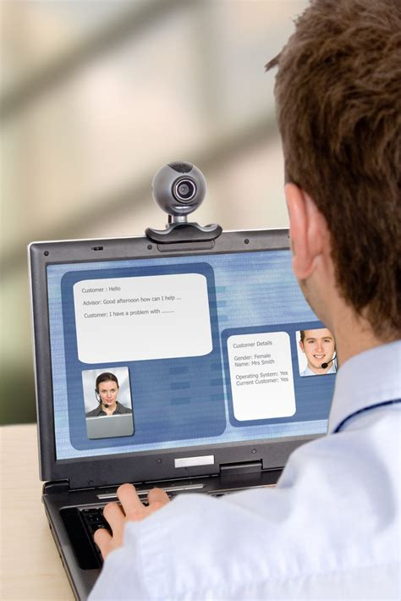
Best Practices for Functions
Function Naming
Use descriptive names for functions that reflect their purpose and behavior.
Function Length
Keep functions concise and focused on a single task to enhance readability and maintainability.
Documentation
Add comments and docstrings to explain the purpose, parameters, and return values of the function.

Slide 13

Thank You

